Slide 1
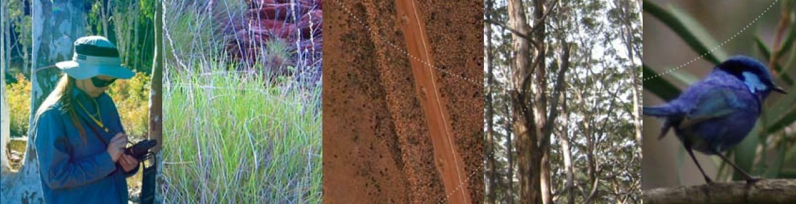
GAIA RESOUR,CES
South Australian Heritage Atlas
Claire Smith and Heather Burke, Flinders University
Piers Higgs, Gaia Resources
Presented Stocktaking Workshop, 18th August, 2012

Slide 2
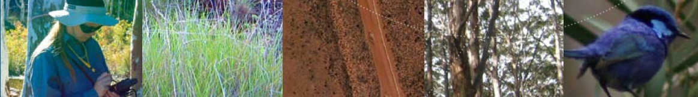
SA HERITAGE ATLAS
Topics covered
General overview
Data collection
Data storage
Data provision
Implementation options

Slide 3
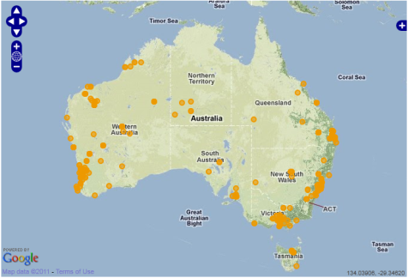
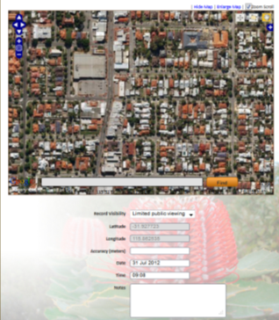
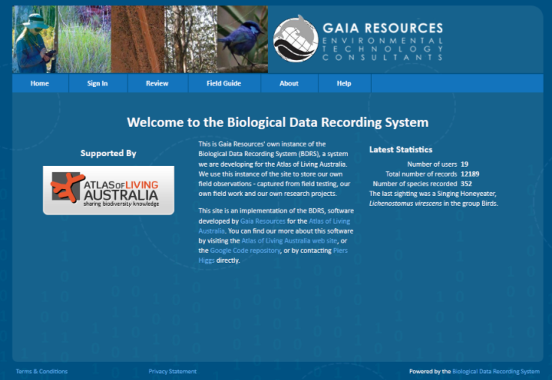
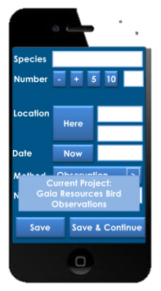
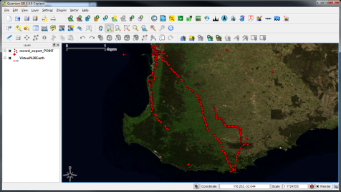
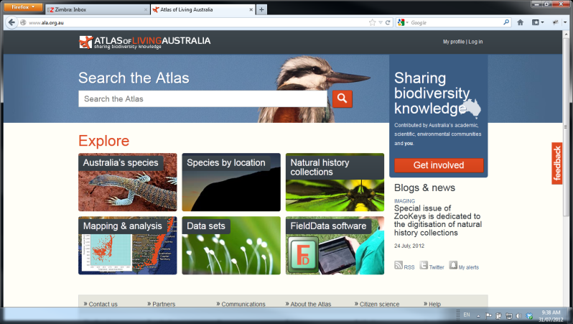
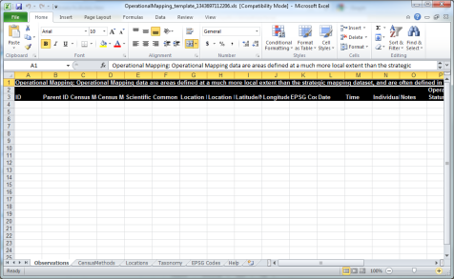
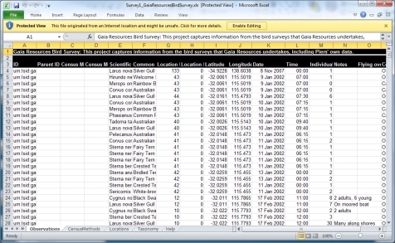
SA HERITAGE ATLAS
General Overview
Data Storage
Data Collection
Data Provision

Slide 4
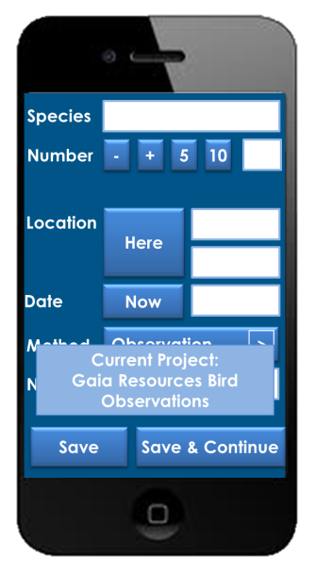
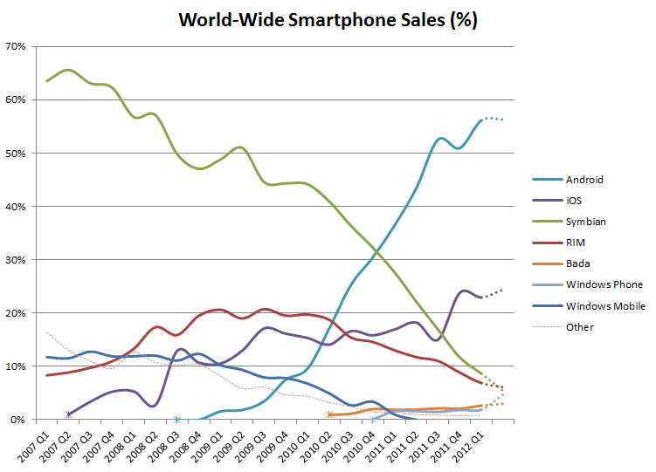
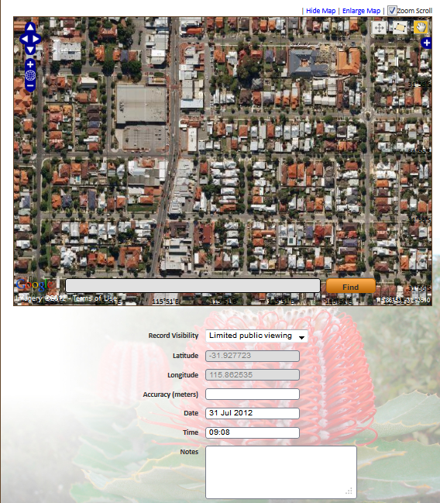
SA HERITAGE ATLAS
Data Collection
Do you want to engage the general public?
2011 – 476.74 million

Slide 5
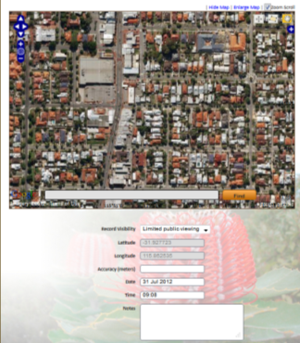
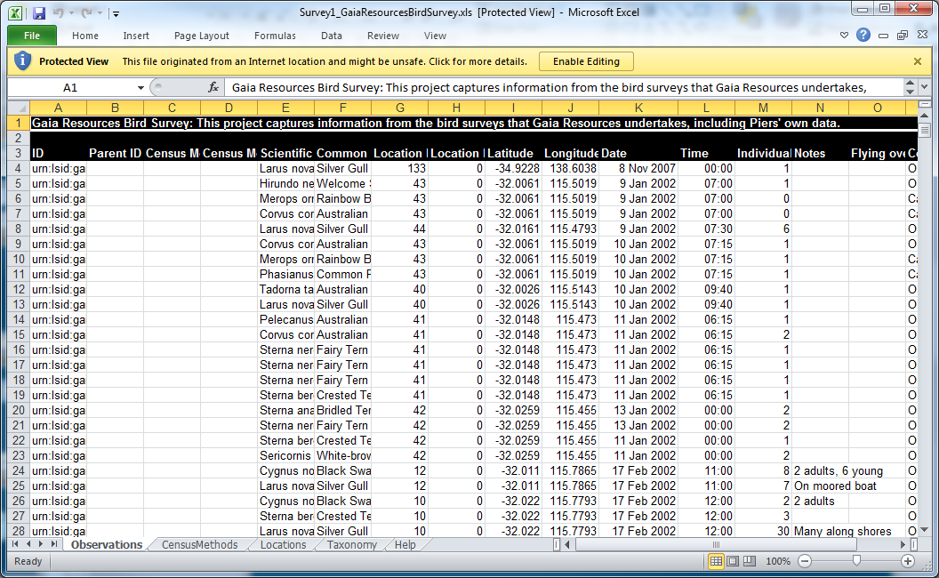

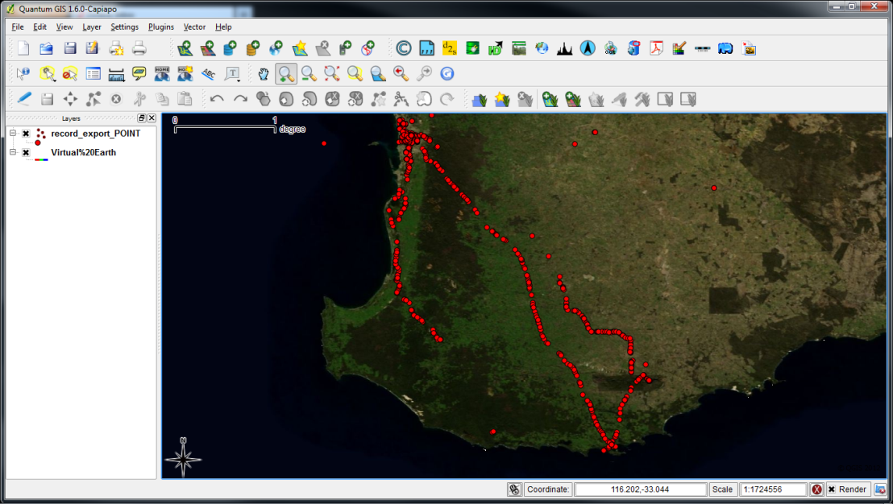
SA HERITAGE ATLAS
Data Collection
Do you want to engage professionals?

Slide 6

SA HERITAGE ATLAS
Data Storage
Several tools are available to act as a centralised storage mechanism
“Light”
“Heavy”

Slide 7
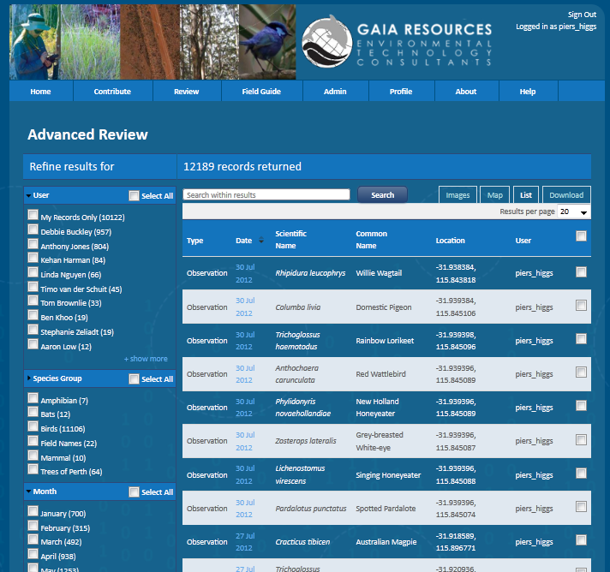
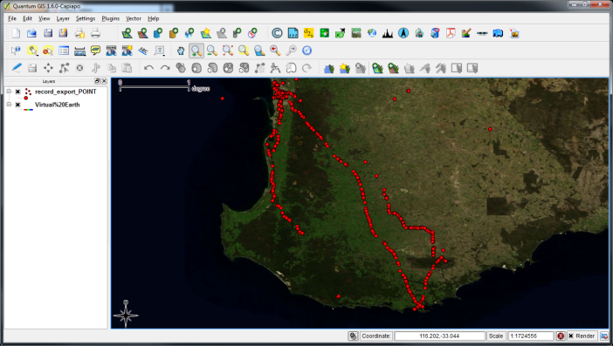
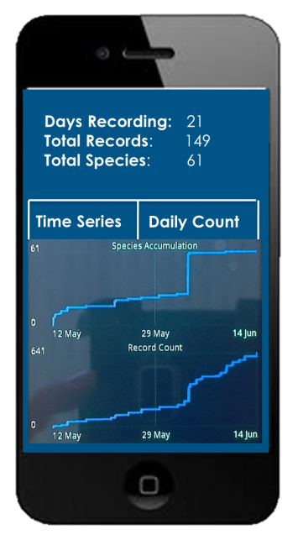
SA HERITAGE ATLAS
Data Provision
How do you deliver data back to stakeholders?
Web?
Download?

Slide 8
SA HERITAGE ATLAS
Implementation Options
There are a range of open source and closed source tools out there that can deliver this functionality
Biological Data Recording System (BDRS) and the Atlas of Living Australia (ALA) Biocache software are examples
You can string these solutions together in different ways for the workflows that are needed

Slide 9
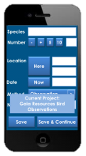

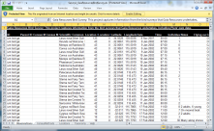


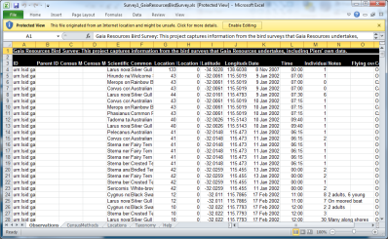

SA HERITAGE ATLAS
Implementation Options (Light)
Web Services
Built Heritage
SA Heritage Atlas
Indigenous Heritage
Downloads

Slide 10

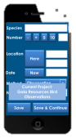



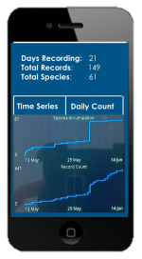
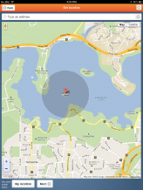
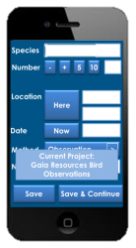
SA HERITAGE ATLAS
Implementation Options (Heavy)
SA Heritage Atlas
Web Services
Built Heritage
Indigenous Heritage
Other Apps
Downloads

Slide 11
SA HERITAGE ATLAS
Summary
There are technical solutions that are available now
There is a lot of flexibility in how this can be created
Data Storage
Data Collection
Data Provision

Slide 12
SA HERITAGE ATLAS
PROBLEM OF REDUNDENCY
Technology
Criteria for classification
Databases
STRATEGIES TO AVOID REDUNDENCY
National and international collaboration
Inter-disciplinary collaboration

Slide 13
SA HERITAGE ATLAS
SUSTAINABILITY
Standards embedded in legislation
Data repository embedded in policy
Statutory repositories
Consent at the beginning of project
Information ethics – collection, deposit, accessability
OUTCOME
New capacity to define research priorities
Classification and ranking of heritage assets
Identification and prediction of problems, trends and gaps in cultural heritage management
New community engagement with cultural heritage

Slide 14
SA HERITAGE ATLAS

